Slide 1
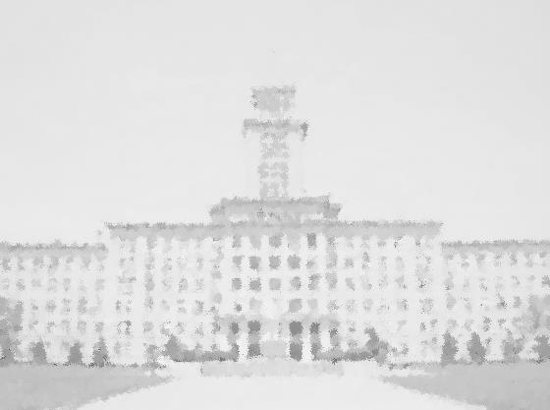


元素有机化学国家重点实验室
State Key Laboratory of Elemento-Organic Chemistry
Nankai University
学 术 报 告
报告题目：Catalytic Enantioselective Redox-Neutral
Processes for Efficient Chemical Synthesis
报告人：赵宇 教授
新加坡国立大学
报告时间：2018年3月12日 下午16:00
报告地点：元素所石先楼学术报告厅
Professor ZHAO Yu ：
Employment
2017.7- present Associate Professor of Chemistry, NUS
2011.8- 2017.6 Assistant Professor of Chemistry, NUS
2008- 2011 Postdoctoral associate with Prof. Richard R. Schrock
Massachusetts Institute of Technology
Education
2002- 2008 Ph.D. in Chemistry with Prof. Marc L. Snapper & Amir H.
Hoveyda, Boston College
1998- 2002 B.S. in Chemistry with Prof. Limin Qi, Peking University
Research interests
Efficient catalytic methodology development
Medicinal chemistry
Pharmaceutical manufacturing
Organic material and polymer chemistry
Recent representative publications
1. Poh, S. B.; Ong, J. Y.; Lu, S.;* Zhao, Y.* Angew. Chem. Int. Ed. 2018,57, 1645-1649.
2. Wang, Y. N.; †Yang, L. C.; †Rong, Z.-Q.; Liu, T.-L.; Liu, R.; Zhao, Y. * Angew. Chem. Int. Ed. 2018,57, 1596-1600.
3. Li, W.; Boon, J. K.; Zhao, Y. * Chem. Sci. 2018,9, 600-607.
4. Rong, Z.-Q.; †Yang, L.-C.; †Liu, S.; Yu, Z.; Wang, Y.-N.; Tan, Z. Y.; Huang, R.-Z.; Lan, Y.;* Zhao, Y.* J. Am. Chem. Soc. 2017, 139, 15304-15307.
5. Lim, C. S.; Quach, T. T.; Zhao, Y. * Angew. Chem. Int. Ed. 2017, 56, 7176-7180 (VIP).

