Slide 1
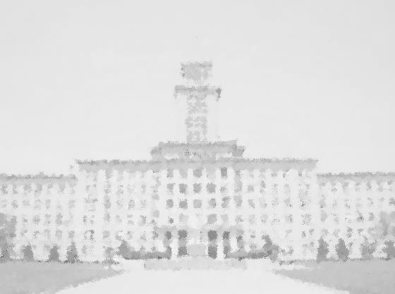


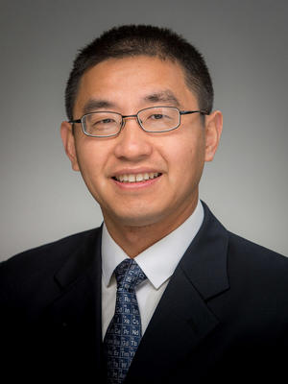
元素有机化学国家重点实验室
State Key Laboratory of Elemento-Organic Chemistry
Nankai University
学 术 报 告
报告题目：Synthesis and Application of Functional Polymers with Highly Branched Nanostructures
报 告 人： Professor Haifeng Gao
University of Notre Dame
报告时间：2018年1月11日 上午10:00
报告地点：南开大学八里台校区6教222会议室
报告人简介
Haifeng Gao is an Associate Professor at the Department of Chemistry & Biochemistry, University of Notre Dame. After receiving his Ph.D. degree in 2008 from Matyjaszewski group at Carnegie Mellon University and his postdoc training in Frechet group at UC Berkeley, he in 2011 joined the University of Notre Dame as an assistant professor. In May 2017, Haifeng was promoted to Associate Professor with tenure. His current research focuses on the design and synthesis of functional polymers with controlled nanostructures by determining their fundamental structure-property relationships. Haifeng has co-authored more than 70 peer-reviewed papers and 6 book chapters. His publications so far have been cited for more than 4000 times. Haifeng was the recent recipient of 2010 AkzoNobel Award for Outstanding Graduate Research in Polymer Chemistry from ACS, 2014 Army Young Investigator Program (YIP) award, 2016 NSF CAREER award.
报告内容简介
This presentation discusses his recent progress on developing new strategies to synthesize functional polymers with controlled nanostructures and exploring their intriguing properties. One-pot polymerization methods were developed for facile synthesis of hyperbranched polymers with tunable molecular weights, low polydispersity and high degree of branching. These strategies include 1) the polymerization of inimers in confined space and 2) chain-growth polymerization of AB₂ monomers in solution. The produced hyperbranched polymers can be easily functionalized with various reactive groups in different layers and show promising properties as unimolecular containers in nanomedicines and polymer catalysis.
申请圣母大学的同学请提前联系如下三位教授：
Professor Haifeng Gao (Organic Chemistry): hgao@nd.edu
Professor Vlad Iluc (Inorganic Chemistry): viluc@nd.edu
Professor John Parkhill (Physical and Analytical Chemistry): john.parkhill@nd.edu
Advance Applicataion online at: gradconnect.nd.edu/apply/

