Slide 1
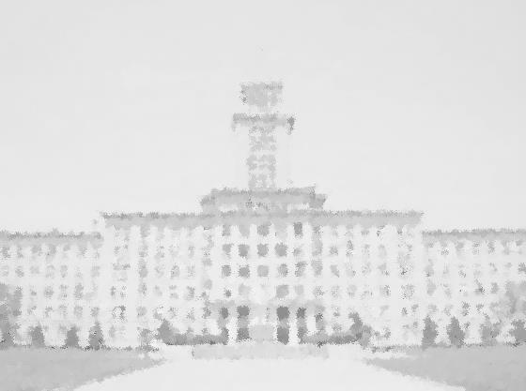
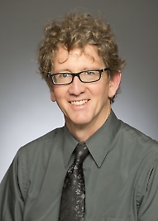
元素有机化学国家重点实验室
State Key Laboratory of Elemento-Organic Chemistry
Nankai University
学 术 报 告
报告题目：2-Azaallyl Anions and Sulfenate Anions: Unusual and Unexpected Reactivity
报告人：Prof. Patrick J. Walsh
University of Pennsylvania
Alan MacDiarmid Professor of Chemistry (2008-to present)
Professor of Chemistry, University of Pennsylvania (2005-present)
Associate Professor of Chemistry, University of Pennsylvania (2002-2005)
Assistant Professor of Chemistry, University of Pennsylvania (1999-2002)
Assistant Professor of Chemistry, San Diego State University (1994-1999)
1991-1994 NSF Postdoc., Scripps Research Institute (Barry Sharpless)
1991 Ph.D. in Chemistry University of California, Berkeley (R. G. Bergman)
ABSTRACT: The umpolung synthesis of diarylmethylamines via palladium-catalyzed arylation of 2-azaallyl anion intermediates and related reactions will be presented. Next, the observation that that 2-azaallyl anions can behave as organic super-electron-donors (SED) will be introduced. Such unique behavior is illustrated in (i) generation of 2-azaallyl radicals from single-electron-transfer (SET) between 2-azaallyl anions and neutral ketimines, which then couple with vinyl bromides; (ii) generation of 2-azaallyl radicals from SET of 2-azaallyl anions with aryl and alkyl electrophiles, which generate aryl and alkyl radicals leading to formation of C–C bonds. Finally, some novel organocatalysts will be described.
报告时间：2018年1月5日 下午16:00
报告地点：元素所石先楼学术报告厅
欢迎师生参加！

