Slide 1
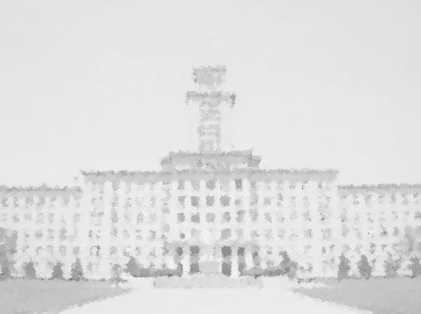
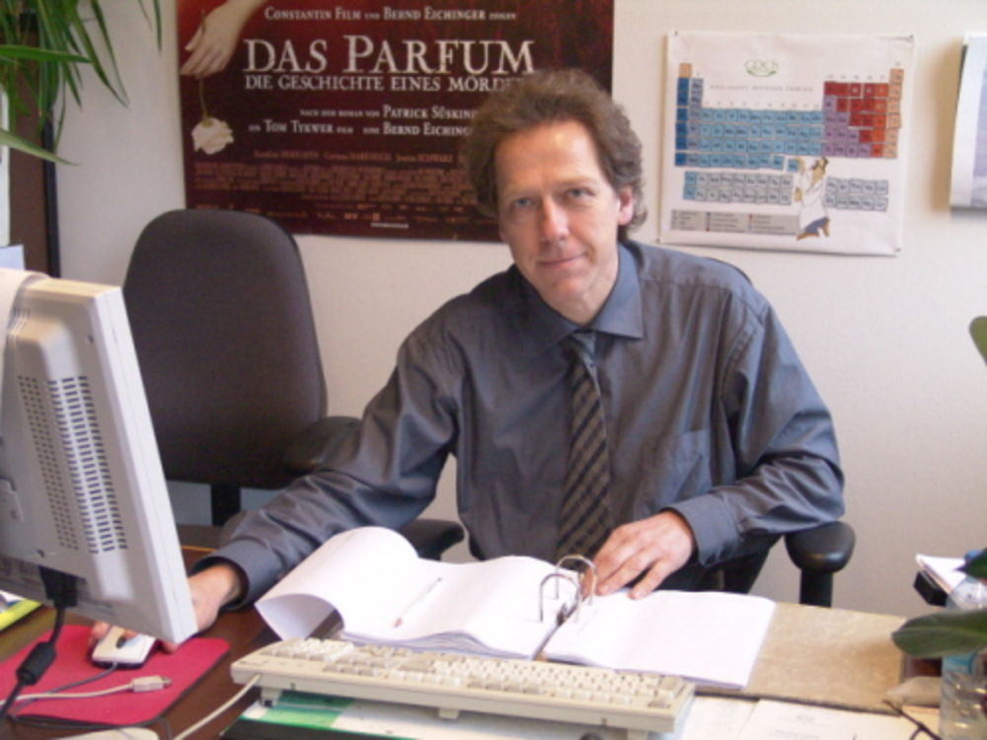
元素有机化学国家重点实验室
State Key Laboratory of Elemento-Organic Chemistry
Nankai University
纪念陈茹玉院士诞辰100周年系列学术活动
An Old Hat with New Feathers –
Heteroldianions as Precursors for
Unusual Silicon and Germanium Compounds
报告题目：
主讲人：
Prof. Dr. Thomas Müller
Carl von Ossietzky University Oldenburg,
Oldenburg, Germany, European Union
1999-2005
2005-2006
Assistant Professorship (C1-Position), Goethe Universität Frankfurt, FRG
Deputy Professor (C4-Position) of Main Group Organic Chemistry at the Universität Rostock, FRG
Full Professor (W3-Position) of Main Group Chemistry at the Carl von Ossietzky Universität Oldenburg, FRG
since 2006
Research Interests: Element Organic Chemistry, Group 14 Chemistry, Physical Organic Chemistry, Computational Chemistry, NMR Spectroscopy, Bond Activation, Catalysis, Unusual Compounds.
报告时间：2018年11月14日(周三)下午16:00
报告地点：元素所石先楼二楼学术报告厅
热烈欢迎各位师生参加！

